Slide 1
The theory of polyelectrolyte brushes and its application to intrinsically disordered proteins
Takashi Yokokura
Prof. Rui Wang
Wed, March 12th, 2025

Slide 2
“We are witnessing the merger of Physics, Chemistry, and Biology with the fastest growth occurring at the interfaces between these disciplines. Polymer physics, as the most mature part of soft matter and biophysics, is uniquely poised to be at the center of this growth.” – M. Rubinstein
Journal of Polymer Science: Part B: Polymer Physics 2010, 48, 2548–2551

Slide 3
Outline
What are polyelectrolyte (PE) brushes? Why should we care about their physics?
How can we study PE brushes given the complex interactions within them?
How do certain PE brush properties influence how they look and behave?
What can polymer physics provide to biology?

Slide 4
Outline
What are polyelectrolyte (PE) brushes? Why should we care about their physics?
How can we study PE brushes given the complex interactions within them?
How do certain PE brush properties influence how they look and behave?
What can polymer physics provide to biology?

Slide 5
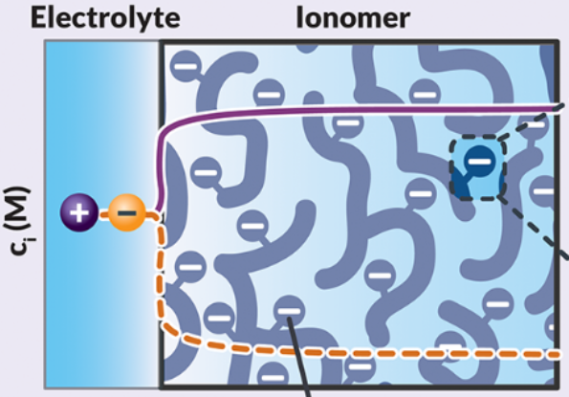
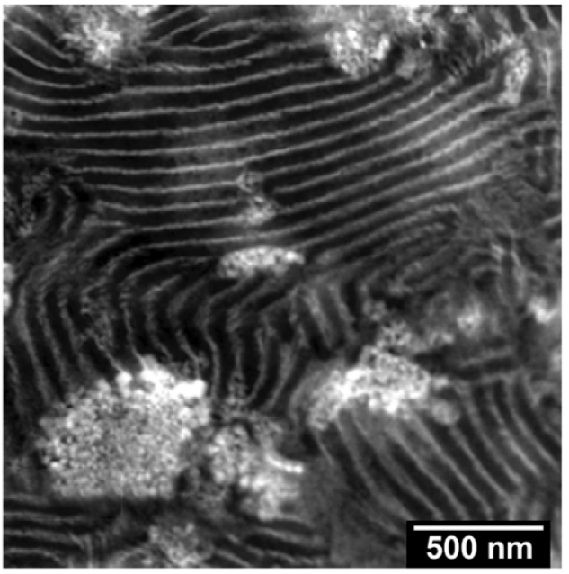
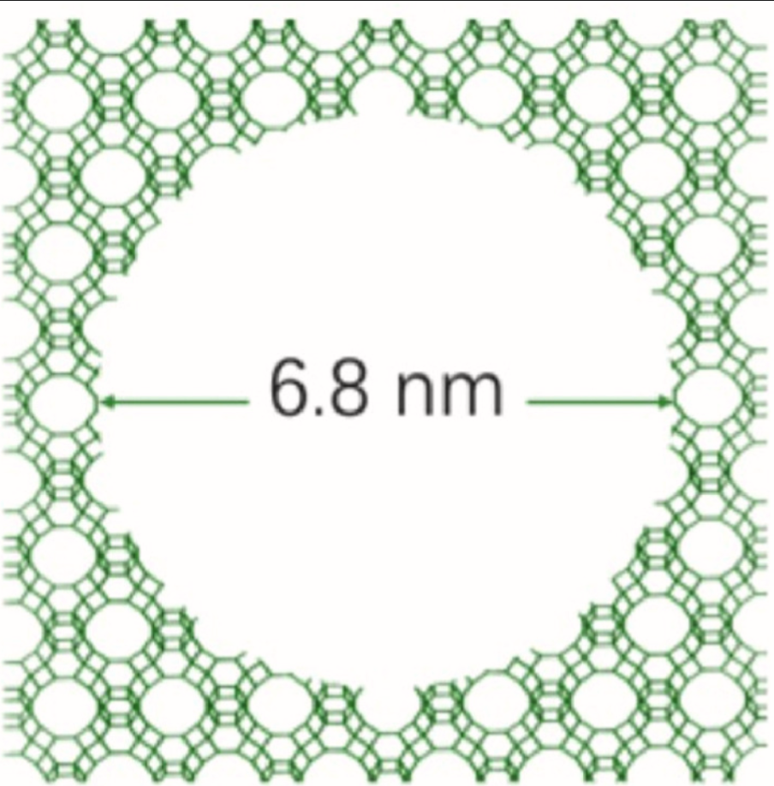
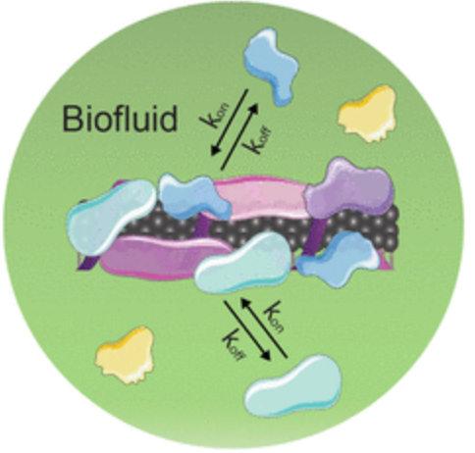
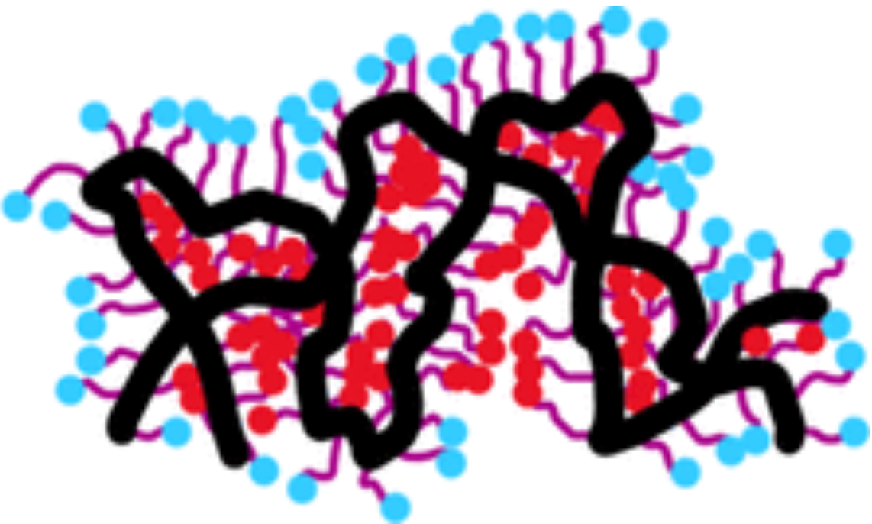
Polymers are everywhere—just look around you
Ionomers in electrochemical cells reducing CO₂
Polymer—ceramic composite electrolytes for Li metal batteries
Mesoporous Y zeolite catalysts using polymeric surfactant
Biocorona formation on nanoparticle-based sensors
Nafion aggregation in fuel-cell catalyst layers
… and more
Bui, Kim, King, et al. Acc. Chem. Res. 2022. 55, 484-494. Li, Martinez, et al. Microporous and Mesoporous Mater. 2024. 373, 113100. Patel et al. Front. Chem. 2023. 11:1199677. Srivastav, Weber, Radke. Langmuir 2024. 40(13), 6666-6674. Voke et al. ACS Sensors 2021. 6(8), 2802–2814.

Slide 6
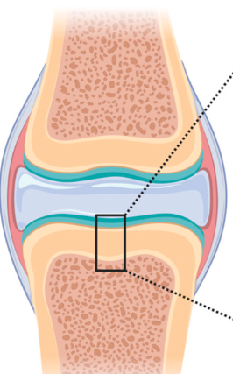
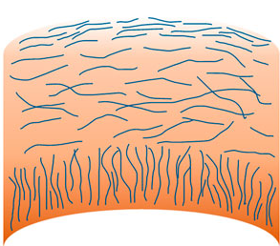
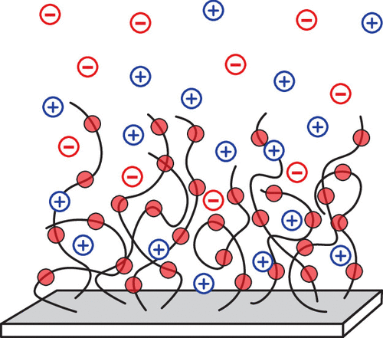
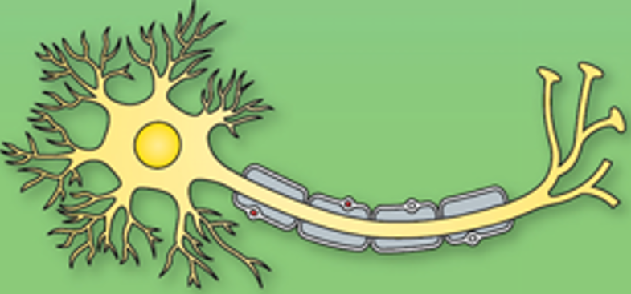
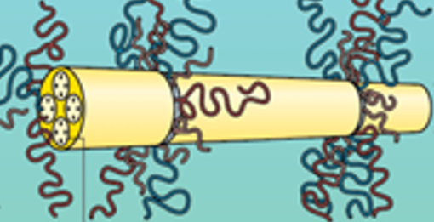
Polymers are everywhere—just look within you
Knee
Articular cartilage
Neuron
Polyelectrolyte (PE) brushes: polymers attached to a surface and whose chains carry a charge
Neurofilament
Liu et al. Front. Bioeng. Biotechnol. 2021. 16. Bačenková et al. Int. J. Mol. Sci. 2023, 24(23), 17096

Slide 7
Polymers are everywhere—just look within you
Knee
Articular cartilage
At the crux of rational design is, “how does the material look and how can I control it?”
“Look” : morphology and microstructure
“Control” : intermolecular interactions
Neuron
Polyelectrolyte (PE) brushes: polymers attached to a surface and whose chains carry a charge
Neurofilament
Liu et al. Front. Bioeng. Biotechnol. 2021. 16. Bačenková et al. Int. J. Mol. Sci. 2023, 24(23), 17096

Slide 8
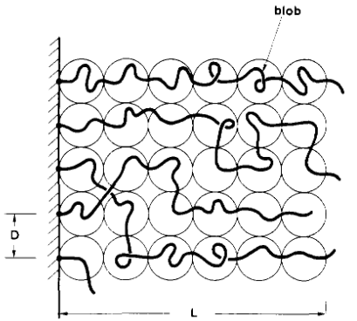
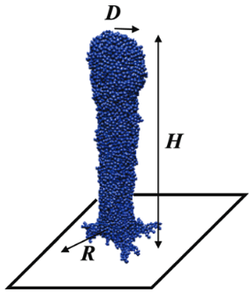
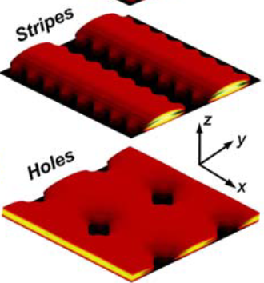
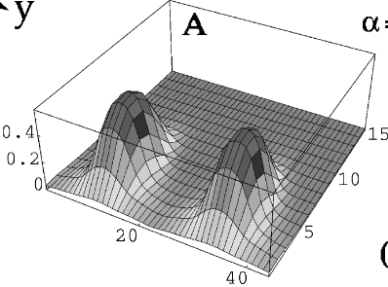
A wealth of PE brush morphologies have been explored theoretically over decades
But, corroboration between theories is limited. Rational design requires an understanding of morphologies’ relations to each other.
de Gennes. Macromolecules 1980, 13(5), 1069–1075. Zhulina, Singh, Balazs. The Journal of Chemical Physics 1998, 108(3), 1175–1183. Carrillo, Dobrynin, Langmuir 2009, 25(22), 13158–13168. Tagliazucchi et al. PNAS 2010, 107(12), 5300–5305.

Slide 9
Outline
What are polyelectrolyte (PE) brushes? Why should we care about their physics?
How can we study PE brushes given the complex interactions within them?
How do certain PE brush properties influence how they look and behave?
What can polymer physics provide to biology?

Slide 10


The physics of PE brushes boils down to three interactions
Elasticity – polymer chains are a series of connected monomers
Hydrophobicity – van der Waals interactions between monomers and solvent
Electrostatics – charged monomeric groups and dissolved salt ions
Monomer
Solvent
$$+$$
$$−$$
Interactions are constantly competing for dominance (coupled). We need a theory that can systematically include all interactions.

Slide 11
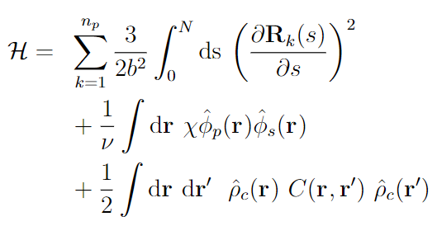

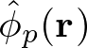
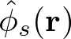
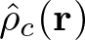
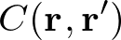
The tool: self-consistent field theory (SCFT)
Elasticity (Gaussian chain)
Hydrophobicity (Flory—Huggins)
Electrostatics
Polymer path
Local polymer volume fraction
Local solvent volume fraction
Local charge density
Coulomb operator

Slide 12
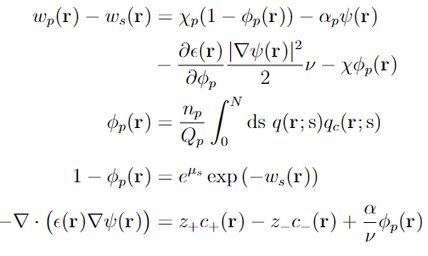
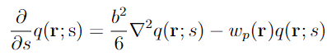
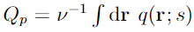
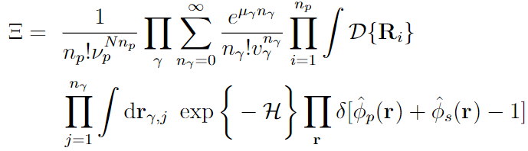
The tool: self-consistent field theory (SCFT)
Interactions
Self-consistent field equations
Standard self-consistent field procedure
System
(Particle-to-field and Hubbard—Stratonovich transforms, saddle-point approximation, functional minimization)

Slide 13
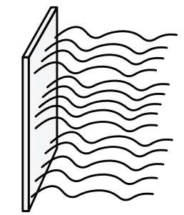
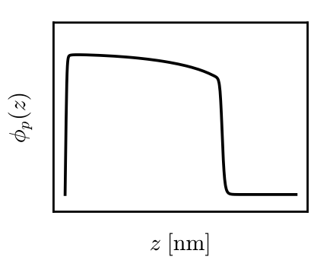
Obtaining brush morphology and microstructure from SCFT
Brush microstructure
Self-consistent field equations
Solve
Propagate
Polymer density distribution
Yes
Self-consistent?
No
Iterate

Slide 14
Outline
What are polyelectrolyte (PE) brushes? Why should we care about their physics?
How can we study PE brushes given the complex interactions within them?
How do certain PE brush properties influence how they look and behave?
What can polymer physics provide to biology?

Slide 15
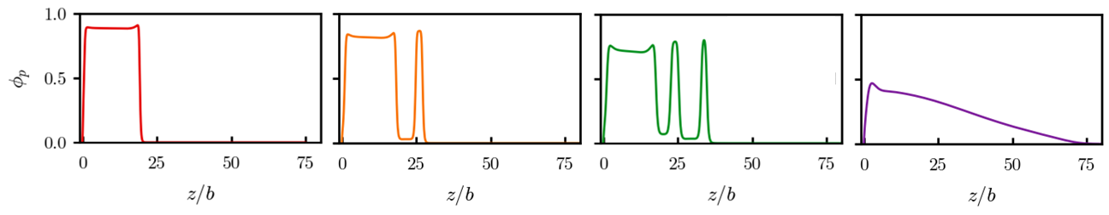
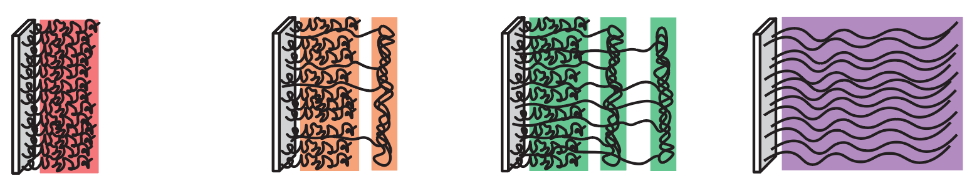
Competition between PE charge fraction and hydrophobicity causes multilayered morphologies
For constant charge fraction ($α=0.4)$ and varying hydrophobicity ($χ$),
Polymer density distributions
Microstructure
Fully condensed
(attraction-dominated)
Microphase segregated
Fully swollen (repulsion-dominated)
Yokokura, Duan, Wang. Macromolecules 2025. 58, 379-388.

Slide 16
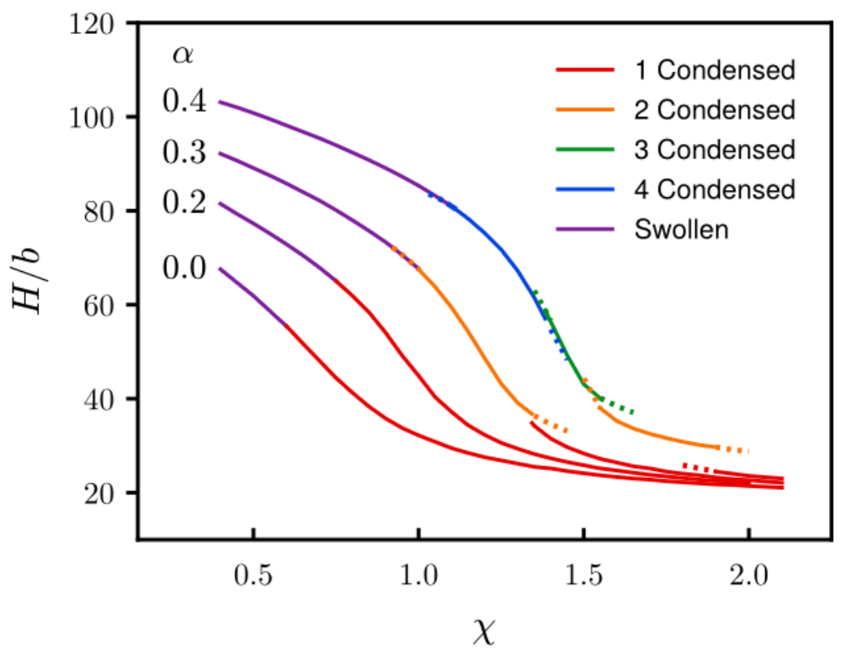
Competition between PE charge fraction and hydrophobicity causes multilayered morphologies
As charge fraction is increased, multilayer morphologies with more layers become accessible
Yokokura, Duan, Wang. Macromolecules 2025. 58, 379-388.

Slide 17


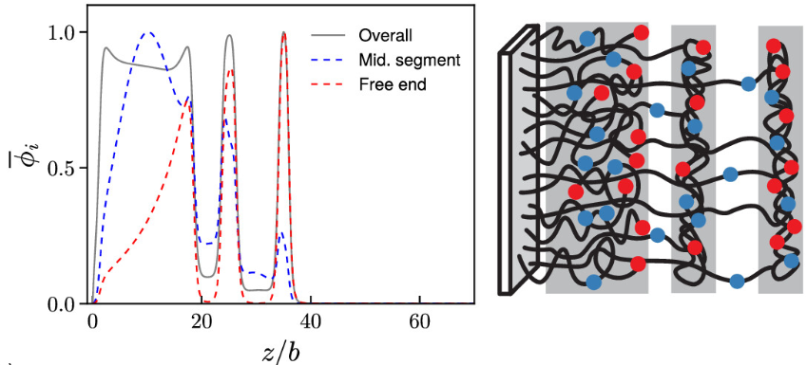

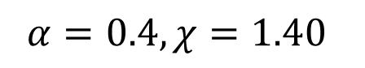
Multilayered PE brushes are composed of separate subpopulations of chains
$$α=0.4, χ=1.40$$
Mid-point less common further away
Free end more common further away
Free end non-existent between layers
Yokokura, Duan, Wang. Macromolecules 2025. 58, 379-388.

Slide 18
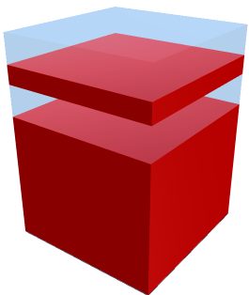
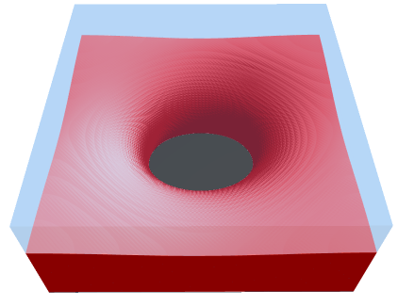
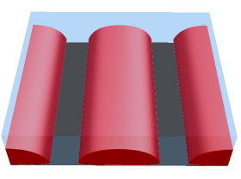
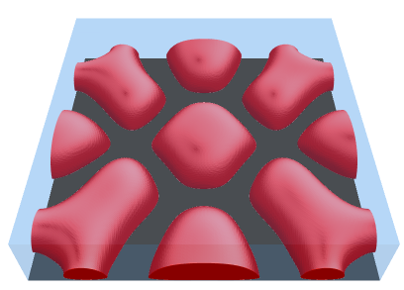
Multilayer PE brush morphologies are favorable at high grafting densities
For constant charge fraction ($α=0.35)$ & hydrophobicity ($χ=1.25$), and varying grafting density $σ$,
Multilayer
Hole
Stripe
Pinned micelle
(Isosurface plots at $φ_{p}=0.10$)
Yokokura, Duan, Wang. In progress

Slide 19
Outline
What are polyelectrolyte (PE) brushes? Why should we care about their physics?
How can we study PE brushes given the complex interactions within them?
How do certain PE brush properties influence how they look and behave?
What can polymer physics provide to biology?

Slide 20
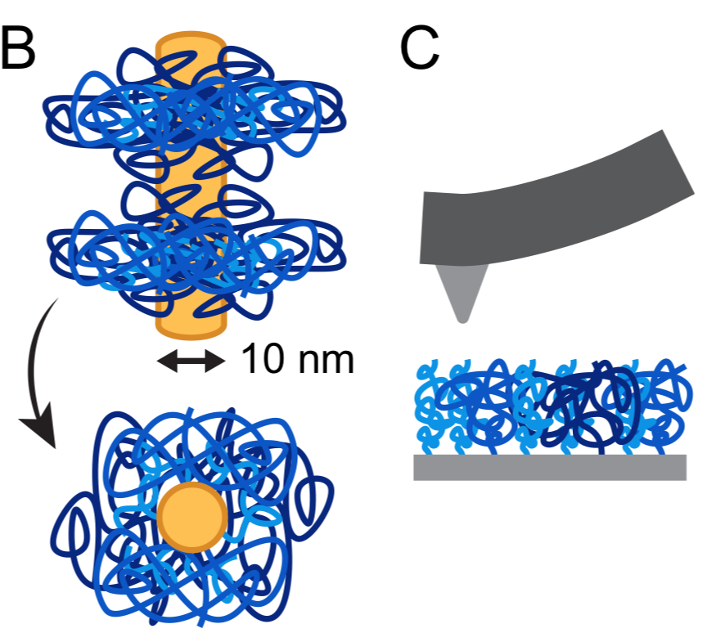
Application of theory to biomacromolecules
Intrinsically disordered proteins (IDPs) pose unique challenges for study
Don’t take folded conformations
Each amino acid can possess its own charge and hydrophobicity
However, IDPs such as neurofilaments are crucial to life
Neurofilaments added complexity of being multicomponent
3-year collaboration with Erika Ding of Kumar group
Robust experimental framework for synthesizing neurofilament-derived protein brushes and measuring their height

Slide 21
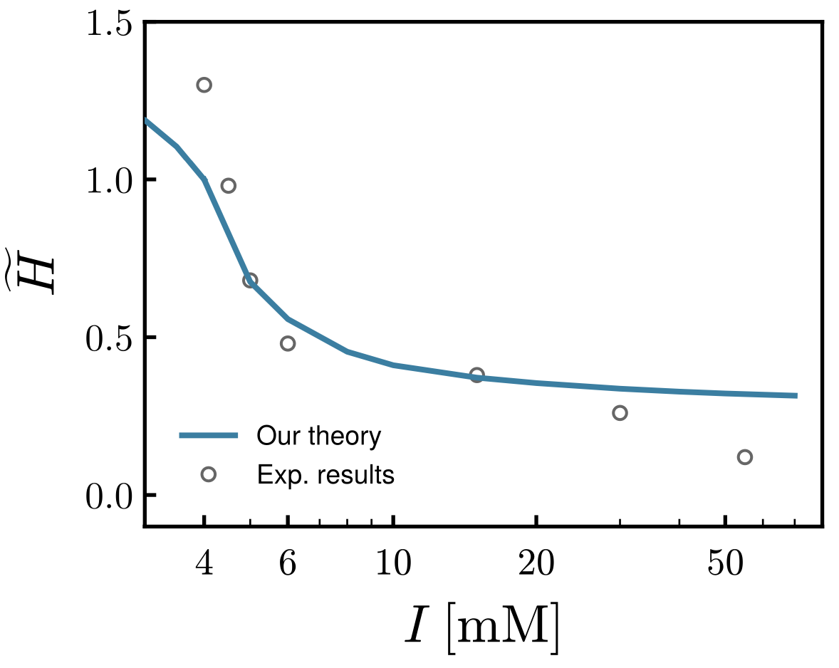
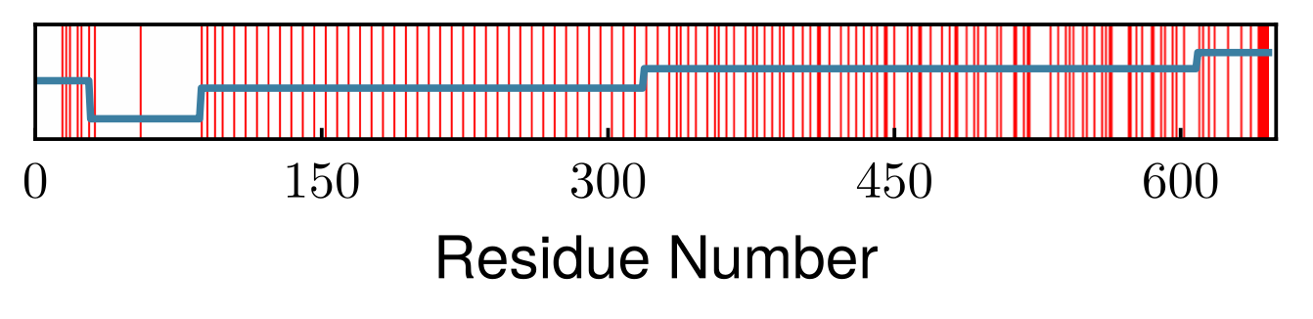
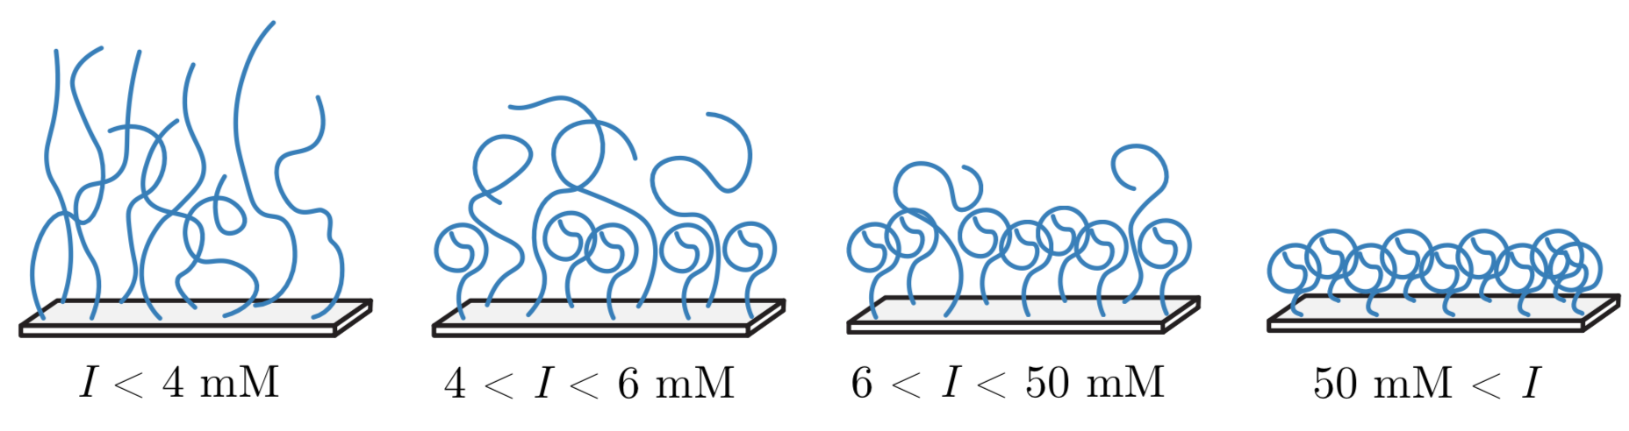
Theory provides microscopic mechanisms for macroscopic changes
Coarse-graining without losing chemical detail
Good agreement with experimental results
Mechanism: conformational transition through coexisting morphology
Yokokura, Duan, Ding, Kumar, Wang. Biomacromolecules 2024. 25(1), 328-337.

Slide 22
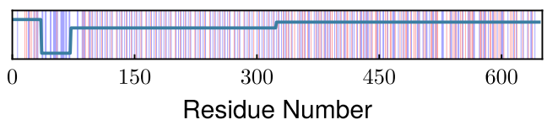
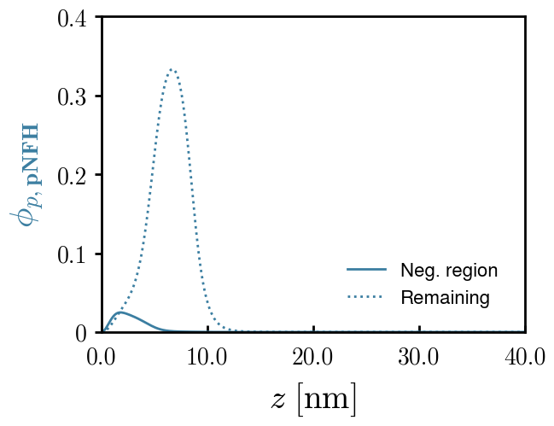
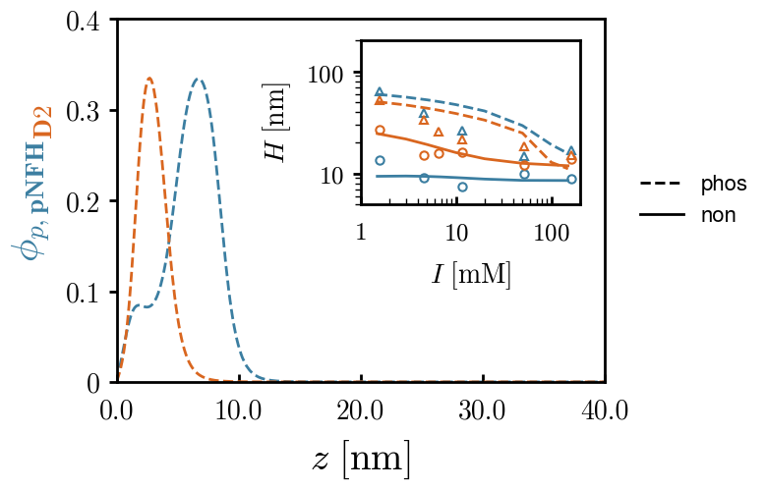
Sequence—structure relationship can be probed by informing experiments
Theory: negatively charged region expels phos. NFH into solution
Expt: deleting this region shrinks brush consistent with theoretical predictions
Ding, Yokokura, Wang, Kumar. PNAS 2024. 121(49), e2410109121

Slide 23
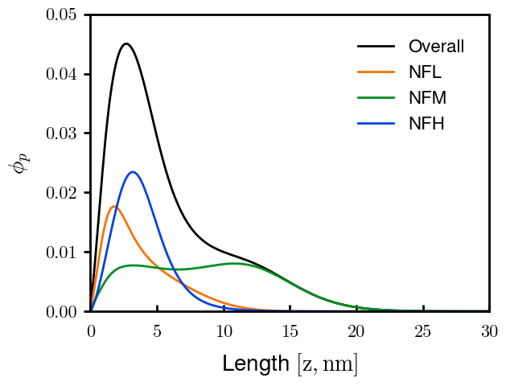
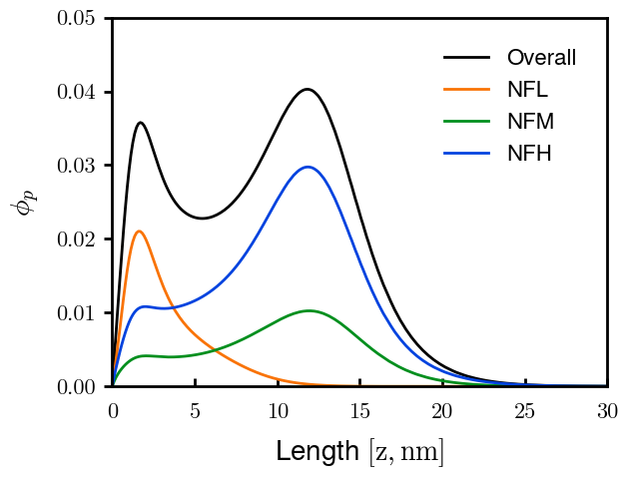
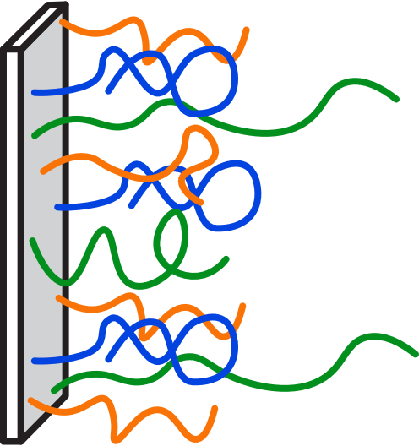
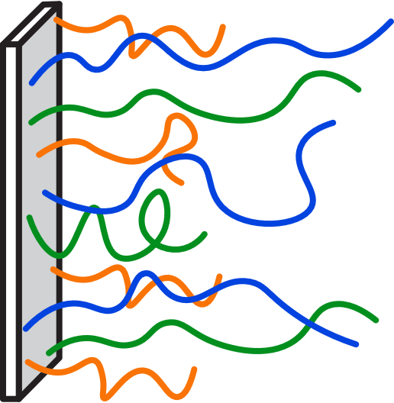
Theory provides the roles of each subunit in multicomponent brushes
Phosphorylation
NFL: Negatively charged core at surface
NFM: Multilayered scaffolding
NFH: Expelled by NFL and NFM upon phos.
Ding, Yokokura, Wang, Kumar. PNAS 2024. 121(49), e2410109121

Slide 24
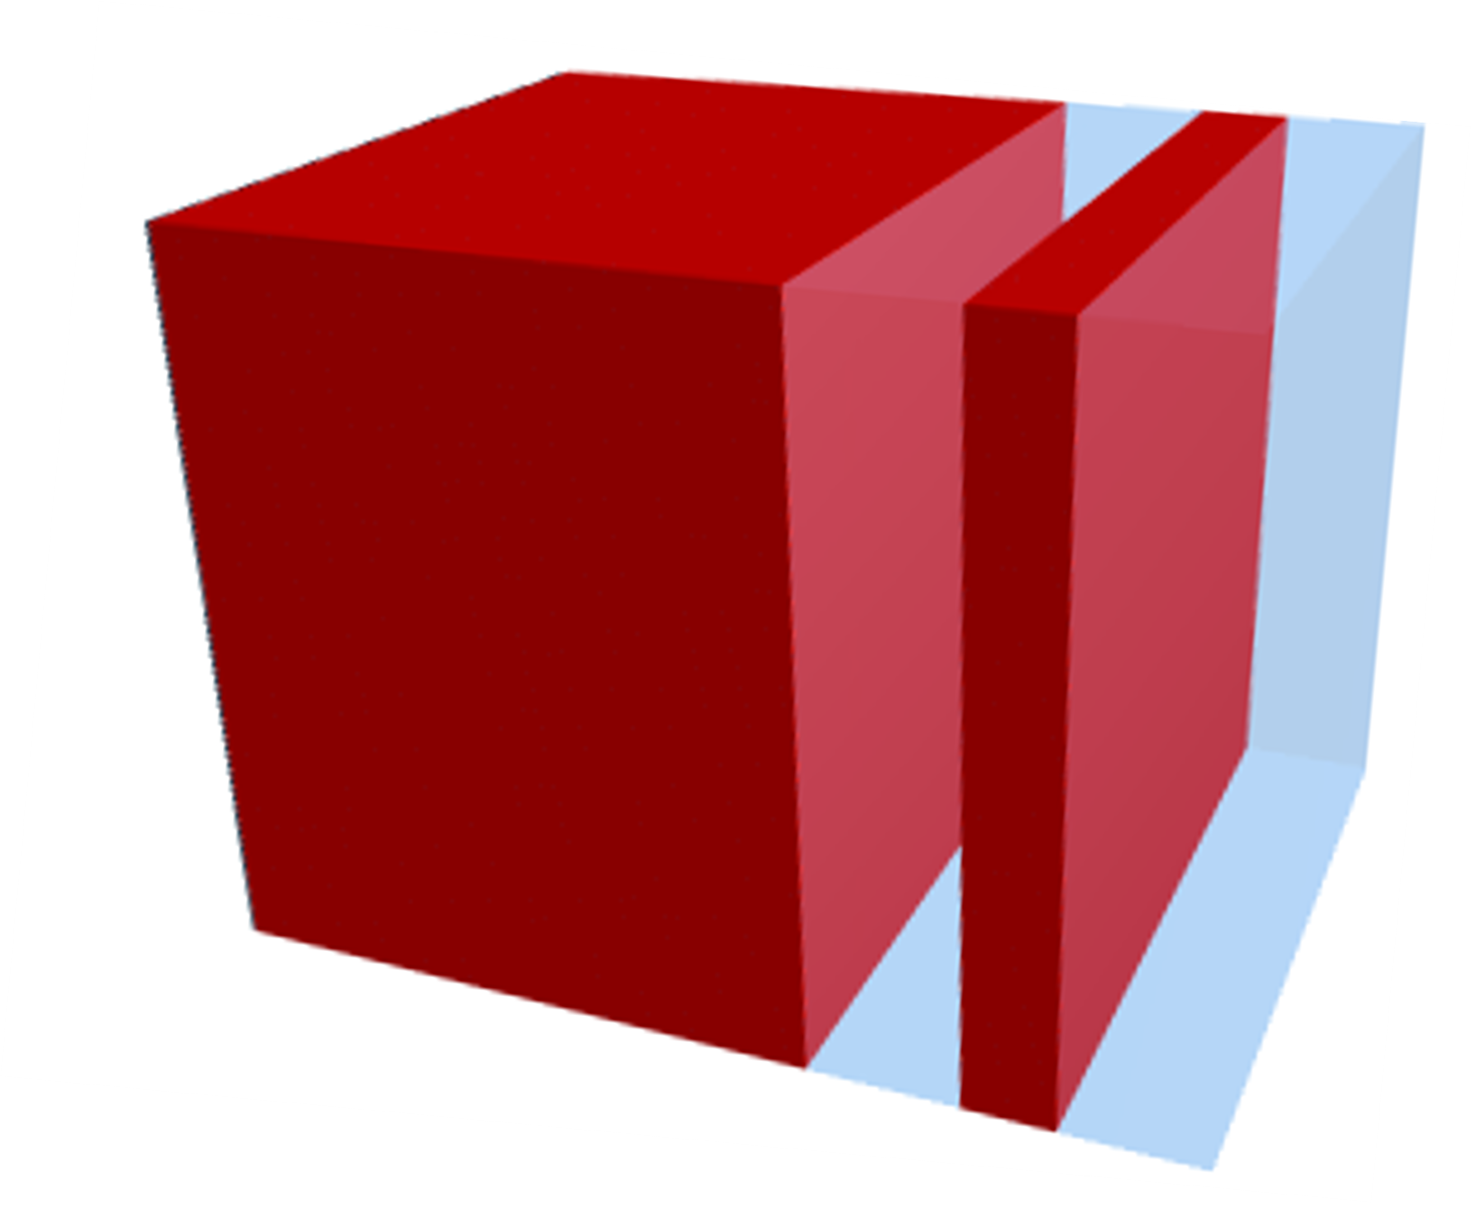
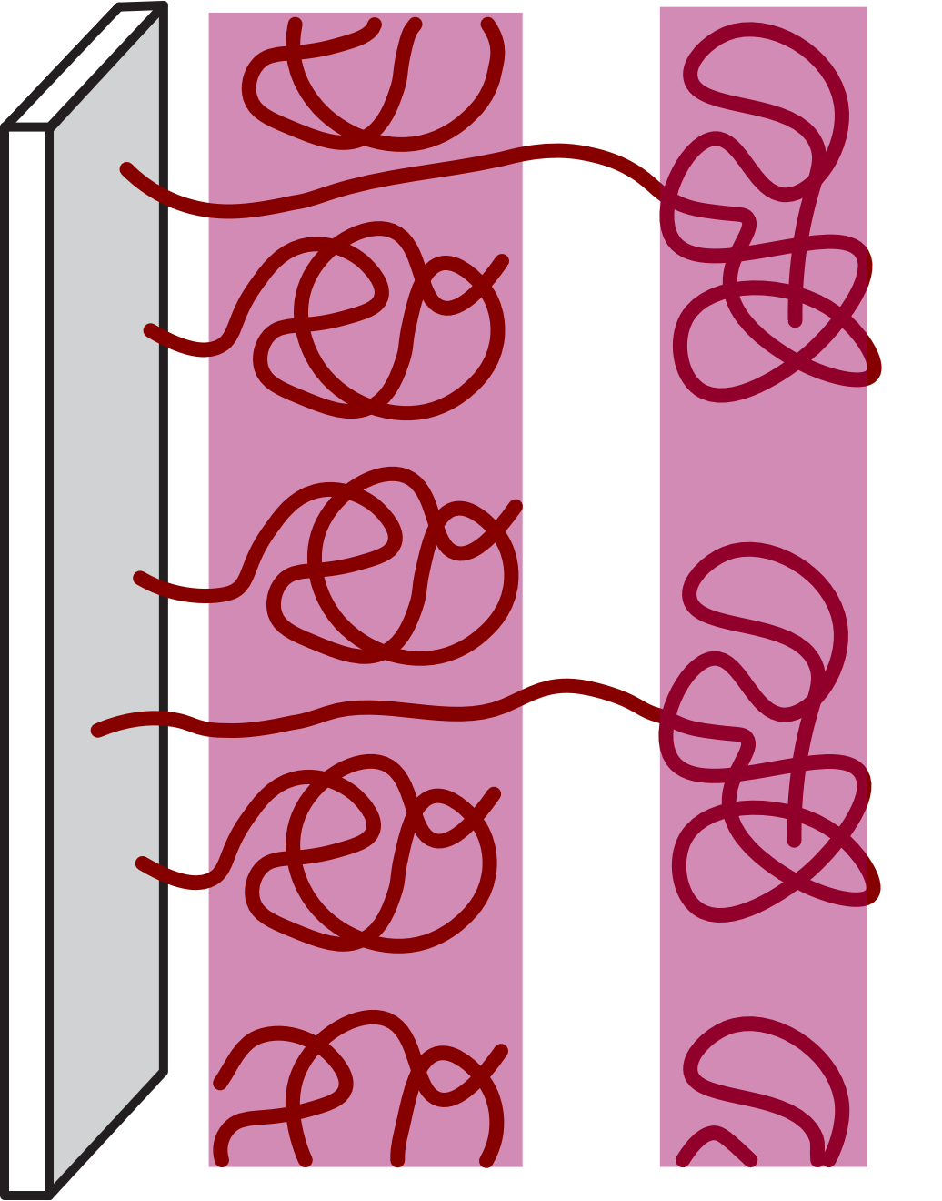
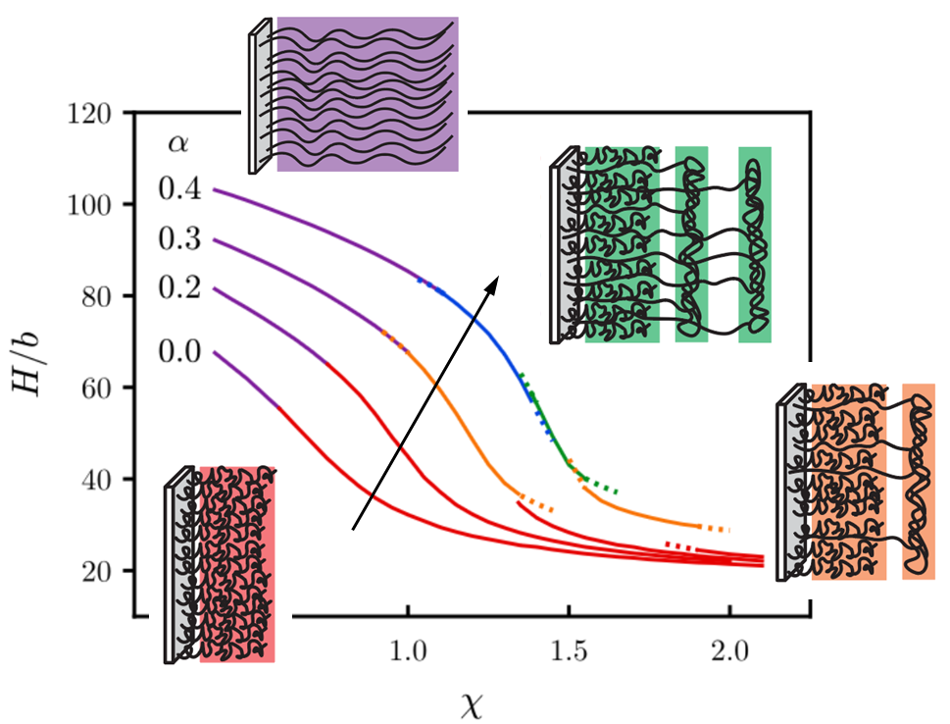
Conclusions
Morphology
Microstructure
PE brushes possess a wealth of morphologies we have yet to fully understand
SCFT provides the microstructure (look) and the interactions (control) governing their behavior
Our theory provides a unified picture for brush morphologies across the parameter space
Our theory provides the sequence—structure (chemistry—physics) relationship in multicomponent neurofilament-derived brushes (biology)
NFL NFM NFH

Slide 25
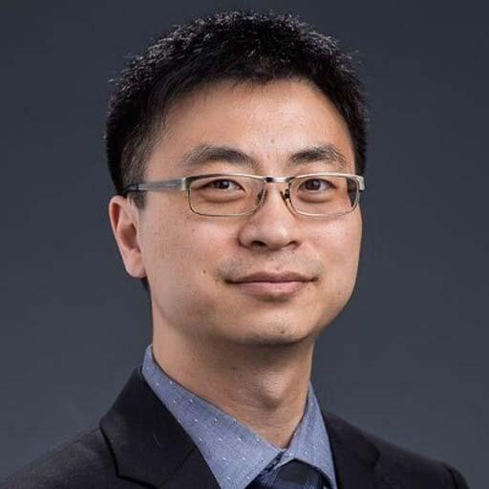

Acknowledgements
Mentors
Prof. Rui Wang
Prof. Joelle Frechette
Marissa Yáñez, Ph.D.
Collaborators
Erika Ding, Ph.D., Prof. Sanjay Kumar
Wang Group (Chao Duan, Nikhil, Ian, Chao Fang)
Undergrads (Kent, Terran, Josh)
Funding
NSF GRFP
Blavatnik Innovation Fellowship
Graduate Assembly
Graduate Division

Slide 26
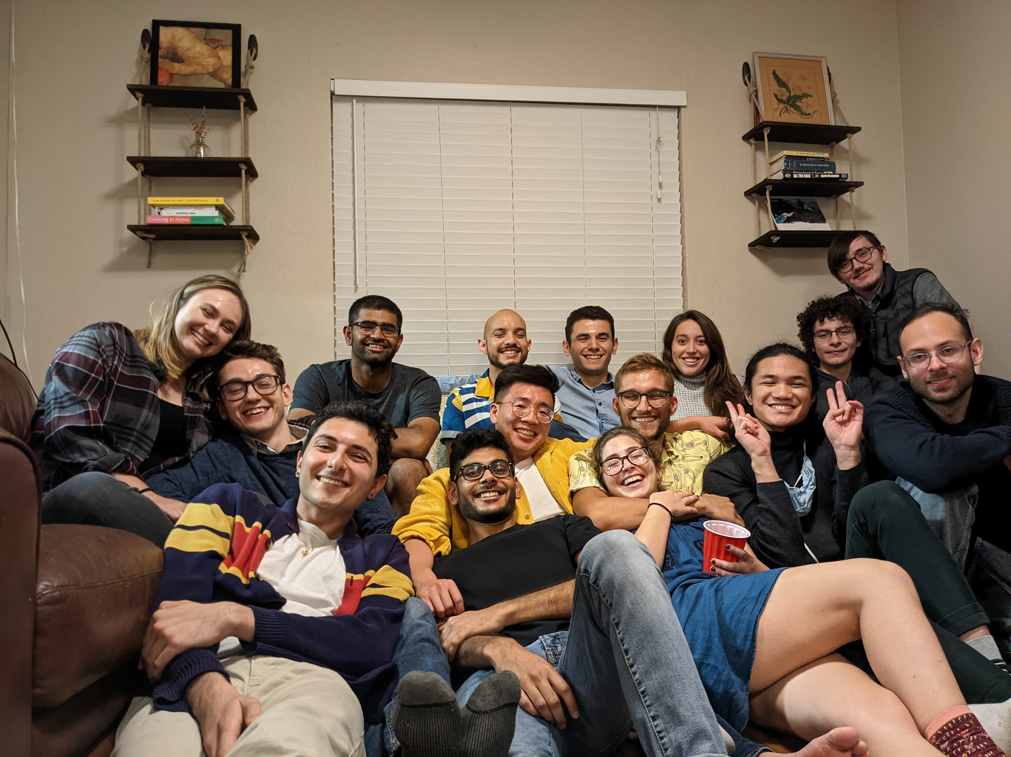















Friends

Slide 27






Family

Slide 28




<3

